Slide 1
Status update

Slide 2
What I got done
Putting the pipeline into a class
Thought dumping into rapport (EDIT: not thought dumping correctly)

Slide 3
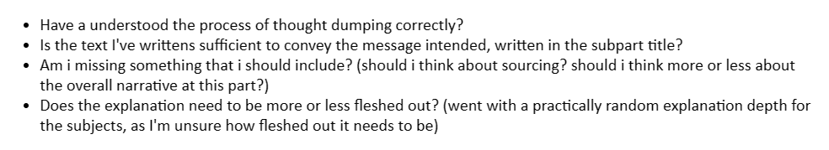
Questions theme: Am I doing it correctly?

Slide 4
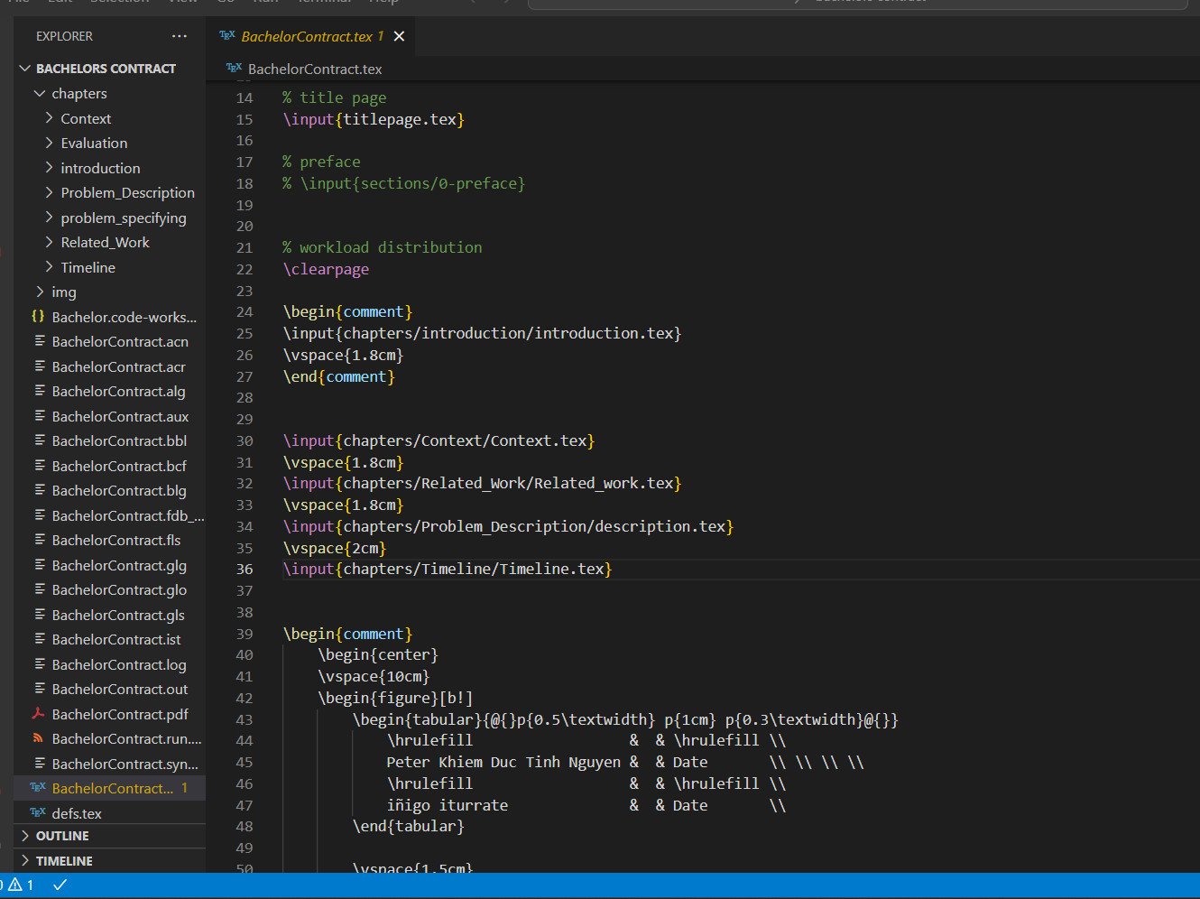
Latex structure

Slide 5
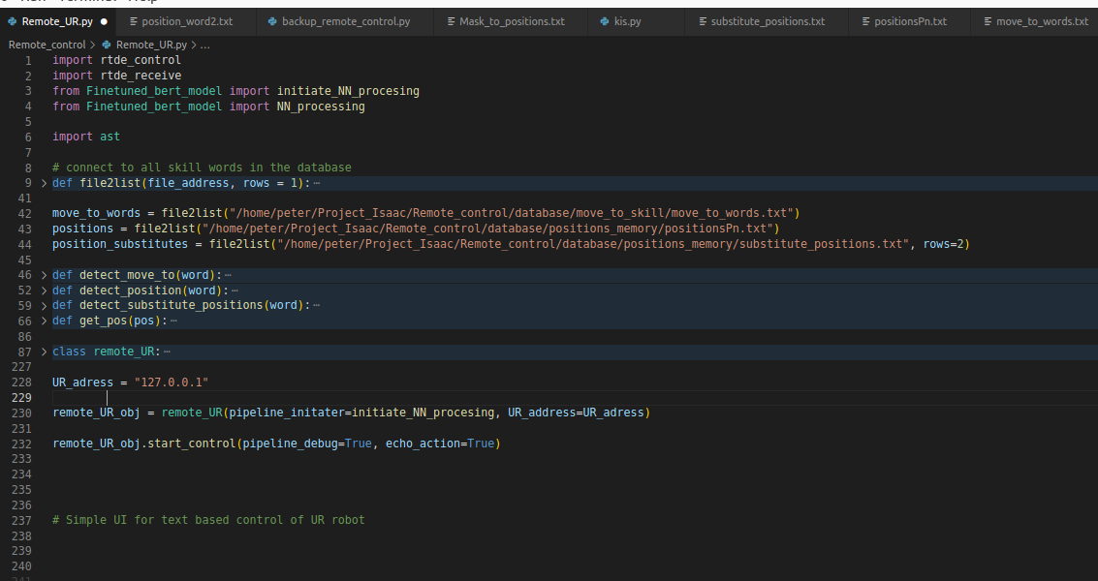
Class based remote control pipeline

